Slide 1
More Than Just Playing with Kittens Foster Training

Slide 2
Welcome

Slide 3
Highs and Lows of Fostering
Clean up – possible damage
Separate foster room
Death of an animal
Say good bye
Socialize them
Use our vets
Not your animals
Financial obligation
Monitor health
Strictly indoors
Adult supervision with children
Own animals current on vaccinations and altering
Saving lives
Making a difference in your community

Slide 4
Who Goes to Foster Care?

Slide 5
Foster Agreement
You will sign this every time you take a litter or a single kitten home with you
It is your responsibility to know what is expected of you
Compliance is a must

Slide 6
Foster Manual

Slide 7
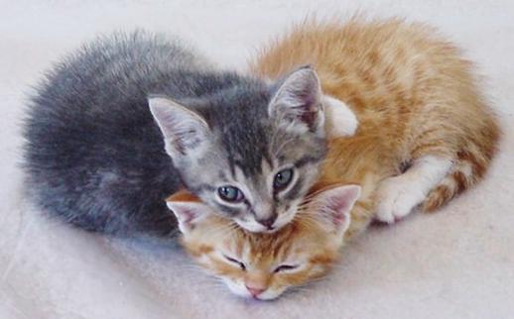
Thank You for Opening Your Heart and Your Home.

Slide 8
Key Responsibilities
Inside at all times
Carrier when leaving the house
Doors and windows closed
Cat escape
Keep them separate
Mixing with your own pets

Slide 9
Mentors
Experienced foster parents
Call with any question
Will help with vaccinations and de-worming
Will help if kitten isn’t doing well
Support system

Slide 10
Kitty Proofing Your Home
Empty room to start
Only items for kittens – bed, litter box, food bowl, water bowl, scratcher, toys
Keep foster baby bag in separate room away from kittens
Cover electrical cords
Don’t use your good linens

Slide 11
Housing
Spare bedroom
Large bathroom
Den
Places not to use: Garage, office that is in use, occupied bedroom, laundry room

Slide 12
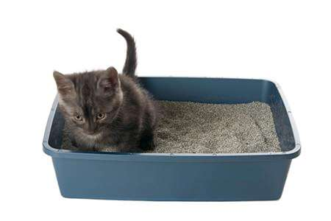
Litter boxes

Slide 13
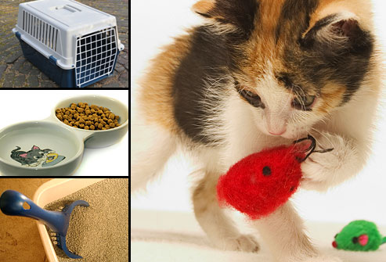
Expenses/Donations
Food
Litter
Litter box
Toys
Scratchers
Mileage to/from shelter and adoption events

Slide 14
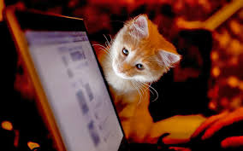
Communication Board

Slide 15
Bringing Them Home
Baby Bag full of supplies
Medical records
Carrier with your kittens
Sign the Foster Agreement
Anything else that may be needed for your foster litter

Slide 16
Naming the Kittens
Orphans will already be named
Cannot change orphans’ names
Kittens with a mom cat you will get to name
Cannot change mom cat’s name

Slide 17
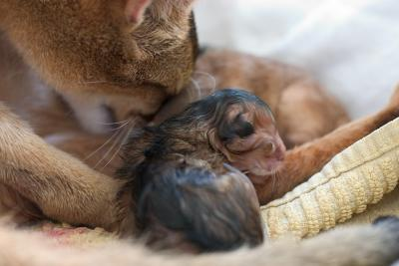
Maternity Guidelines

Slide 18
Socializing Kittens

Slide 19
Food
High quality… canned/dry
Always lots of fresh water

Slide 20
Baby Bag Supplies

Slide 21
Medical Records

Slide 22
Kitten Development & Vaccine Schedule
4 weeks old: 1st dose of Strongid de-wormer
6 weeks old: 2nd dose of Strongid de-wormer, 1st FVRCP vaccination, Petfinder pictures and biography, kittens are available for viewing
8 weeks old: 3rd dose of Strongid de-wormer, schedule surgery with shelter
9 weeks old: 2nd FVRCP
10 weeks old: 4th dose of Strongid de-wormer

Slide 23
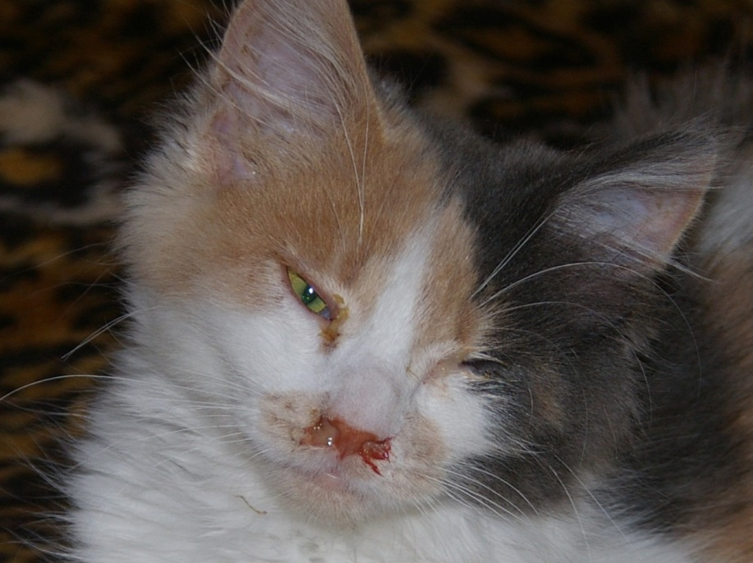
Health Concerns
Discharge from eyes or nose
Coughing
Diarrhea
Vomiting
Straining to urinate or defecate
Bleeding
Lethargy
Fever
Paralysis
Extreme change in attitude
Not eating/drinking
Temperature too low
Temperature too high

Slide 24
Common Ailments
Expect to see at least one of these while fostering. If you don’t, you are one of the lucky ones!
Diarrhea
Upper Respiratory Infection (kitty cold)
Conjunctivitis
Vomiting
Dehydration

Slide 25
General and Emergency Care
CAT will cover all medical expenses done at the shelter
CAT must approve outside expenses
Foster Parents cannot seek medical care on their own without the consent of the shelter

Slide 26
Adoption Process
Pre-Adoption
Adoption
Foster Parents can adopt
No Holds in foster care
Kittens do not go home until they are altered – no exception

Slide 27
A Free Kitty is NEVER Free!

Slide 28
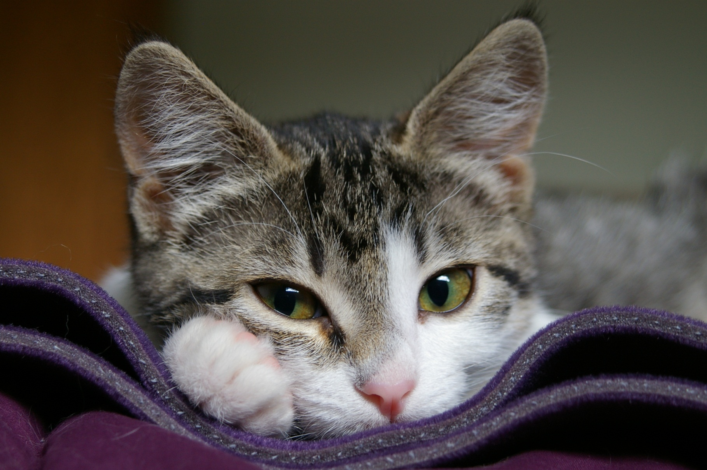
Kitten List

Slide 29
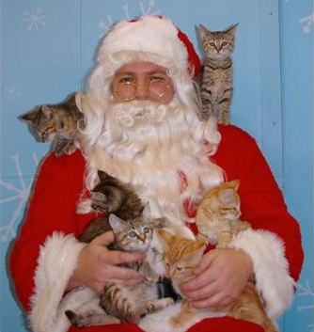
Get Your Kittens Seen
PetSmarts: Clackamas, Tualatin, Washington Square, Tanasbourne
Petco: Tualatin Petco
Kitten Palooza
Additional venues

Slide 30
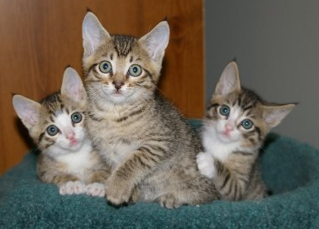
Petfinder – 6 weeks an older

Slide 31
Returning Kittens for Surgery or Adoption
Surgery
Email when kittens are 1.75 lbs
Let Shelter know if they are pre-adopted
If pre-adopted, let adoptive family know the surgery date
Fill out Personality Profile
Fill out Foster Return Form
Collar kittens
Hand in Baby Bag and all supplies

Slide 32
Cleaning for Your Next Group

Slide 33
FAQ’s

Slide 34
Questions?

